Slide 1
Displaying Quantitative Data

Slide 2
Quantitative Data – A Recap
Data that are Numerical & either Interval or Ratio Scale:
Time taken for Level 1 Support
Arrival times of customers
Feedback 1 – 5
Possible questions
Can additional training reduce the average service time
Can we identify peak hours for optimal staffing?
Which unit has the lowest employee satisfaction?

Slide 3
Time Taken*
Year | Time
1875 | 158
1876 | 158
1877 | 158
1878 | 157
1879 | 147
1880 | 148
1881 | 160
1882 | 160
1883 | 163
1884 | 160
1885 | 157
1886 | 157
1887 | 159
1888 | 158
1889 | 155
1890 | 165
1891 | 172
1892 | 162
1893 | 159
1894 | 161
1895 | 158
1896 | 128
1897 | 133
1898 | 129
1899 | 132
1924 | 125
1925 | 128
1926 | 124
1927 | 126
1928 | 130
1929 | 131
1930 | 128
1931 | 122
1932 | 125
1933 | 127
1934 | 124
1935 | 125
1936 | 124
1937 | 123
1938 | 125
1939 | 123
1940 | 125
1941 | 121
1942 | 124
1943 | 124
1944 | 124
1945 | 127
1946 | 127
1947 | 127
1948 | 125
1949 | 124
1950 | 122
1951 | 123
1952 | 122
1953 | 122
1954 | 123
1955 | 122
1956 | 123
1957 | 122
1958 | 125
1959 | 122
1960 | 122
1961 | 124
1962 | 120
1963 | 122
1964 | 120
1965 | 121
1966 | 122
1967 | 121
1968 | 122
1969 | 122
1970 | 123
1971 | 123
1972 | 122
1973 | 119
1974 | 124
1975 | 122
1976 | 122
1977 | 122
1978 | 121
1979 | 122
1980 | 122
1981 | 122
1982 | 122
1983 | 122
1984 | 122
1985 | 120
1986 | 123
1987 | 123
1988 | 122
1989 | 125
1990 | 122
1991 | 123
1992 | 123
1993 | 122
1994 | 124
1995 | 121
1996 | 121
1997 | 122
1998 | 124
1900 | 126
1901 | 128
1902 | 129
1903 | 129
1904 | 129
1905 | 131
1906 | 129
1907 | 133
1908 | 135
1909 | 128
1910 | 126
1911 | 125
1912 | 129
1913 | 125
1914 | 123
1915 | 125
1916 | 124
1917 | 125
1918 | 131
1919 | 130
1920 | 129
1921 | 124
1922 | 125
1923 | 125
1999 | 123
2000 | 121
2001 | 120
2002 | 121
2003 | 121
2004 | 124
2005 | 123
2006 | 121
2007 | 122
2008 | 122
2009 | 123
2010 | 124
Kentucky Derby FinishingTimes

Slide 4
Displaying Quantitative Data
Frequency Distribution
Relative Frequency Distribution
Percentage Relative Frequency Distribution
Cumulative Frequency Distribution
Histogram
Ogive
Dot Plot

Slide 5
Time Taken – Frequency Distributions
FOUR BINS
Class Freq Cumul Relative Frequency
[115,130) 106 106 0.779
[130,145) 9 115 0.066
[145,160) 13 128 0.096
[160,175) 8 136 0.059
NINE BINS
Class Freq Cumul Relative Frequency
[119,125) 73 73 0.5368
[125,131) 35 108 0.2574
[131,137) 7 115 0.0515
[137,143) 0 115 0.0000
[143,148) 2 117 0.0147
[148,154) 0 117 0.0000
[154,160) 14 131 0.1029
[160,166) 4 135 0.0294
[166,172) 1 136 0.0074

Slide 6
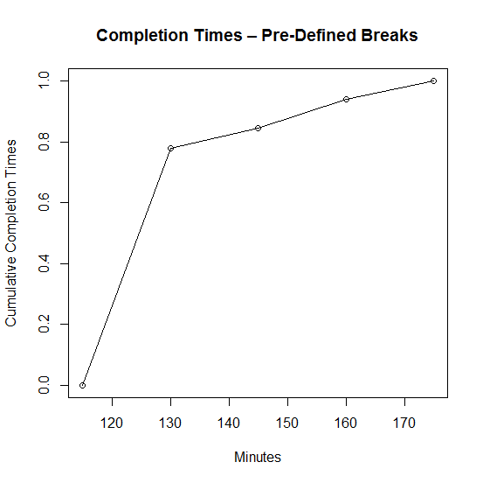
Time Taken – The Ogive
FOUR BINS
Class Cumul Cum Freq (%)
[115,130) 106 78%
[130,145) 115 85%
[145,160) 128 95%
[160,175) 136 100%

Slide 7
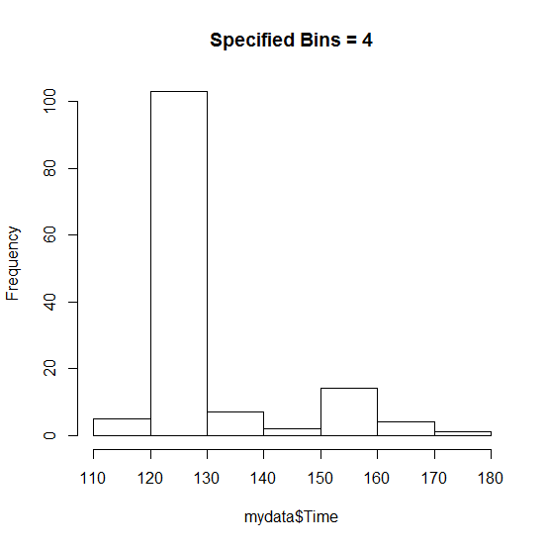
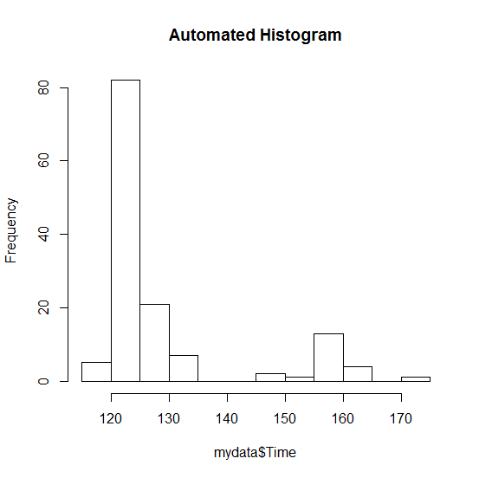
Time Taken – Histograms
Can you draw any inferences from the above histograms (of the same data)?

Slide 8
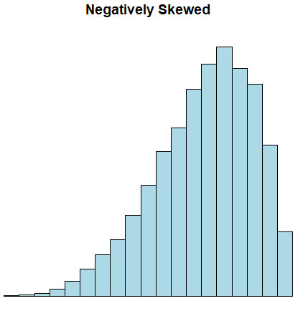
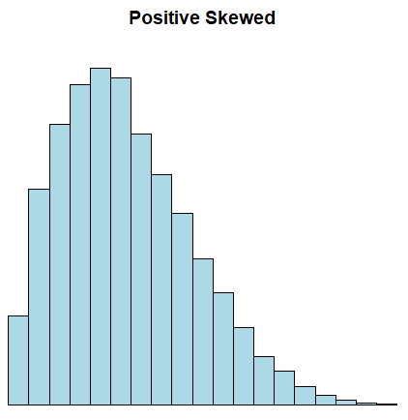
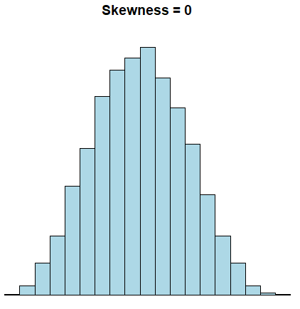
Skewness
Skewness measures the asymmetric nature of the distribution.
A distribution with the peak towards the right and a longer left tail is skewed left or negatively skewed
A distribution with the peak towards the left and a longer right tail is skewed right or positively skewed
A Symmetric distribution has Skewness = 0

Slide 9
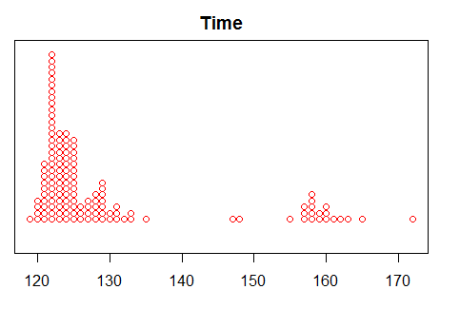
Time Taken – Dot Plot
Can you draw any inferences from the Dot Plot?

Slide 10
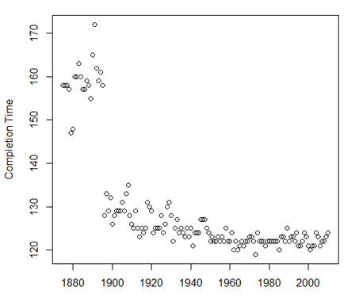
Time Taken – Scatter Plot

Slide 11
Takeaways
Frequency distribution, Histogram, Ogive, Dot Plots
Scatter plot

